Slide 1
Literature Review of Paper 4

Slide 2
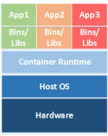
Container Architecture
Host OS
Container runtime
Images
Registry
Microservice
Orchestrator
Notes:
1. Host OS : i) General-purpose OS, ii) Container specific OS
ii) They actively 416 discourage running applications outside containers,
They often use read-only file system.
2. Gives abstraction to OS.
3. Files required to run container.
4. Helps to maintain, store, find, reuse image files.
5. Known
6. Manages different operations between containers.
6.

Slide 3
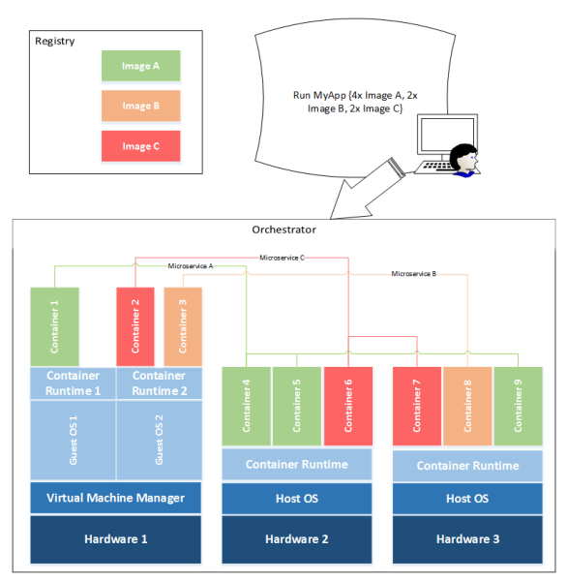
Interaction among container components

Slide 4
Host OS risks
Improper user access rights
Host component vulnerabilities
Countermeasures :
Only the specific set of access required should be provided to the specific resources required for an administrator to perform their job.
Should use tools provided by the OS vendor or other trusted organizations to regularly check for and apply updates to all software components
Notes:
1.
2.

Slide 5
Container runtime risks
Vulnerabilities within the runtime software
Unbounded network access from containers
Insecure container runtime configurations
Shared kernel
Countermeasures :
Carefully monitor, can use tools
Those who access internet more often should be placed at border
Mandatory access control technology provides enhanced control
Group containers by relative sensitivity

Slide 6
Image risks
Image vulnerabilities
Image configuration
Embedded malware
Embedded secrets
Image trust
Countermeasures :
Container-specific vulnerability management tools, frequent app update
Non-privileged users shouldn’t have access to images
Use tools
Sensitive data should never be stored in image files
Enforce a set of trusted images and registries
Notes:
1. Image may often be out of date and missing critical security updates
2. A poor configuration can still expose a fully up-to-date system to attack
3. Images from base layers provided by third parties can contain malware
4. Ex: passwords kept in image files, this practice creates a security risk because anyone with access to the image file can easily parse it to learn these secrets.
5. When troubleshooting a problem with a web application, a user may find another version of that application available in an image provided by a third party. Portability and ease of reuse.

Slide 7
Registry risks
Insecure connections to registries
Stale images in registries
Countermeasures :
Ensure that all data pulled from a registry is encrypted in transit between the registry and the destination.
i) Prune registries of unsafe, vulnerable images that should no longer be used(automated) ii) Operational practices should emphasize accessing images using immutable names that specify discrete versions of images to be used
Notes:
1. Images should not include secrets or user data, if connections to registries are performed over insecure channels, the contents of images are subject to the same confidentiality risks as any other data transmitted.
2. Images can include many vulnerable, out-of-date versions.

Slide 8
Orchestrator risks
Unbounded administrative access
Weak or unmanaged credentials
Unmanaged inter-container network traffic
Mixing of workload sensitivity levels
Countermeasures :
Ex : Test team members should have limited or no access to containers used in production
Use strong authentication credentials, and centralize auditing of access, making anomaly detection more effective
Virtual overlay network security should be ensured
Orchestrators should be configured to isolate deployments to specific sets of hosts by sensitivity levels
Notes:
1.
2.
3. Traffic between individual nodes is routed over a virtual overlay network
4. Workloads of differing sensitivity levels on the same host
4. afficc between individual nodes is routed over a virtual overlay network between individual nodes is routed over a virtual overlay network

